Slide 1
Introduction to .NET and C#
Do Quoc Binh

Slide 2
Understanding the .NET Framework
.NET Framework is a development platform that includes
Common Language Runtime (CLR) manages the execution of code
Base Class Library (BCL) which provides a rich library of classes to build applications from
.NET Framework to have the possibility of being cross-platform but Microsoft put their implementation effort into making it work best with Windows
Since .NET Framework 4.5.2 it has been an official component of the Windows operating system.

Slide 3

Understanding the .NET Framework(cont)
All of the apps on a computer written for the .NET Framework share the same version of the CLR and libraries stored in the Global Assembly Cache (GAC)

Slide 4
Understanding the Mono and Xamarin projects
Third parties developed a .NET Framework implementation named the Mono project.
Mono is cross-platform, but it fell well behind the official implementation of .NET Framework
Microsoft purchased Xamarin in 2016 and now gives away what used to be an expensive Xamarin extension for free with Visual Studio 2019
Microsoft renamed Xamarin Studio to Visual Studio for Mac and gave it the ability to create other types of apps

Slide 5
Understanding .NET Core
Microsoft has been working on an effort to decouple .NET from its close ties with Windows
This new product was branded .NET Core and includes a cross-platform implementation of the CLR known as CoreCLR and a streamlined library of classes known as CoreFX
Improvements that Microsoft can make to .NET Core cannot be added to .NET Framework

Slide 6
Understanding future versions of .NET
NET Core will be renamed .NET and the major version number will skip the number four to avoid confusion with .NET Framework 4.x. So, the next version of .NET Core will be .NET 5.0
Microsoft plans on annual major version releases every November, rather like Apple does major version number releases of iOS every second week in September.

Slide 7
What is different about .NET Core?
.NET Core is smaller than the current version of .NET Framework due to the fact that legacy technologies have been removed.
Windows Forms and Windows Presentation Foundation (WPF) are tightly bound to the Windows ecosystem, so they have been removed from .NET Core on macOS and Linux.
The latest technology used to build Windows apps is the Universal Windows Platform (UWP)
UWP is not part of .NET Core because it is not cross-platform.
ASP.NET Web Forms and Windows Communication Foundation (WCF) have also been removed from .NET Core. Instead, developers prefer to use ASP.NET MVC and ASP.NET Web API

Slide 8
What is different about .NET Core?[2]
Entity Framework (EF) 6 is an object-relational mapping technology will be given support for non-relational databases like Microsoft Azure Cosmos DB, and named Entity Framework Core
Microsoft has componentized the .NET Core into NuGet packages, those being small chunks of functionality that can be deployed independently.
The goal is to componentize .NET Core to support modern technologies and to have fewer dependencies , so that deployment requires only those packages that your application needs.

Slide 9
Understanding .NET Standard
The situation with .NET in 2019 is that there are three forked .NET platforms controlled by Microsoft, as shown in the following list:
.NET Core: for cross-platform and new apps.
.NET Framework: for legacy apps.
Xamarin: for mobile apps.
This has led to the problem that a developer must learn three platforms, each with annoying quirks and limitations.
Because of that, Microsoft defined .NET Standard: a specification for a set of APIs that all .NET platforms can implement

Slide 10
Understanding .NET Standard[2]
To use the .NET Standard, you must install a .NET platform that implements the .NET Standard specification.
.NET Standard 2.0 is implemented by the latest versions of .NET Framework, .NET Core, and Xamarin.

Slide 11
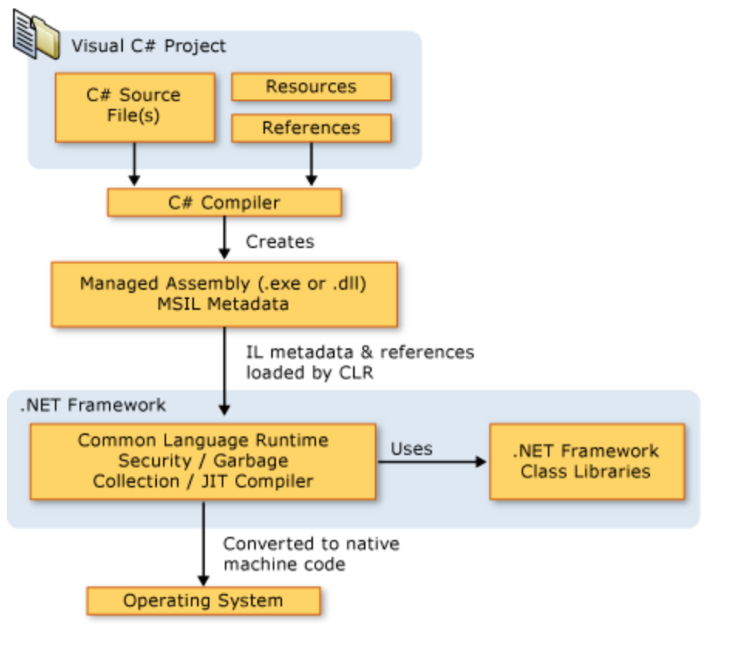
.NET Framework Platform Architecture

Slide 12
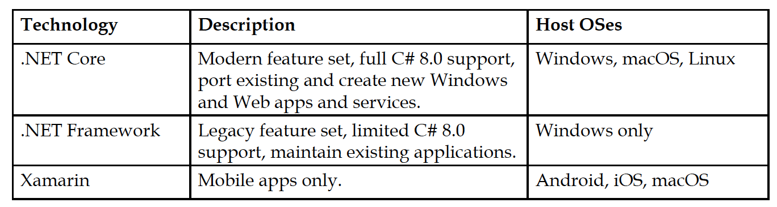
Comparing .NET technologies- year 2019
By the end of 2020, Microsoft promises that there will be a single .NET platform instead of three. .NET 5.0 is planned to have a single BCL and two runtimes: one for desktop and server and one for mobile

Slide 13
Introduction to C#
C# will be instantly recognizable to anyone familiar with C, C++ or Java
C# syntax simplifies many of the complexities of C++ and provides powerful features, which are not found in Java
C# is an an object-oriented language
C# can call COM objects or native Win32 DLLs, you can do this in C# through a process called "Interop"

Slide 14
Understanding language versions and features
C# 1.0 was released in 2002 and included all the important features of a statically typed object-oriented modern language
C# 2.0 was released in 2005 and focused on enabling strong data typing using generics, to improve code performance and reduce type errors
C# 3.0 was released in 2007 and focused on enabling declarative coding with Language INtegrated Queries (LINQ), anonymous types and lambda expressions
C# 4.0 was released in 2010 focused on dynamic type, named arguments

Slide 15
Understanding language versions and features[2]
C# 5.0 was released in 2012 and focused on simplifying asynchronous: async and await
C# 6.0 was released in 2015 focused on minor refinements: static imports, Interpolated strings, Expression bodied members
C# 7.0 was released in March 2017 and focused on adding functional language features like tuples and pattern matching
C# 8.0 was released in September 2019 and focused on Nullable reference types, Switch expressions, Default interface methods

Slide 16
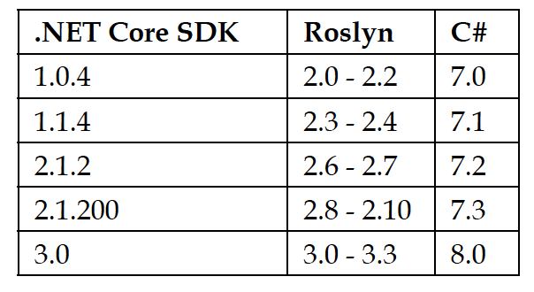
Discovering your C# compiler versions

Slide 17
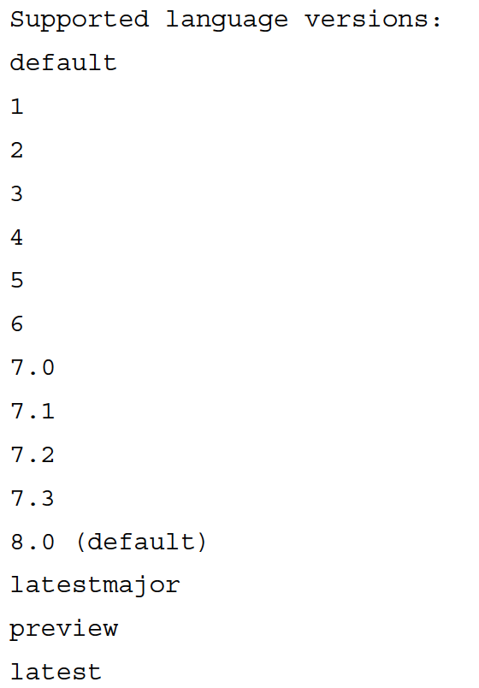
Discovering your C# compiler versions[2]
To determine which version of the .NET Core SDK you have available
[From command line type] dotnet –version
NET Core 3.0 would display = > 3.0.100
To determine which versions of the C# compiler you have available
[From command line type] csc -langversion:?

Slide 18
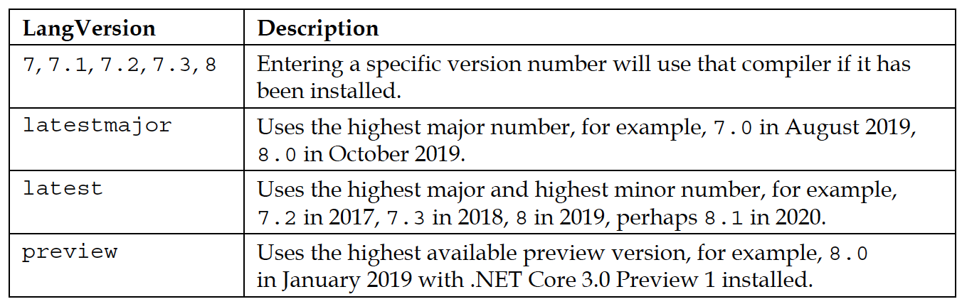
Potential values for the <LangVersion>

Slide 19
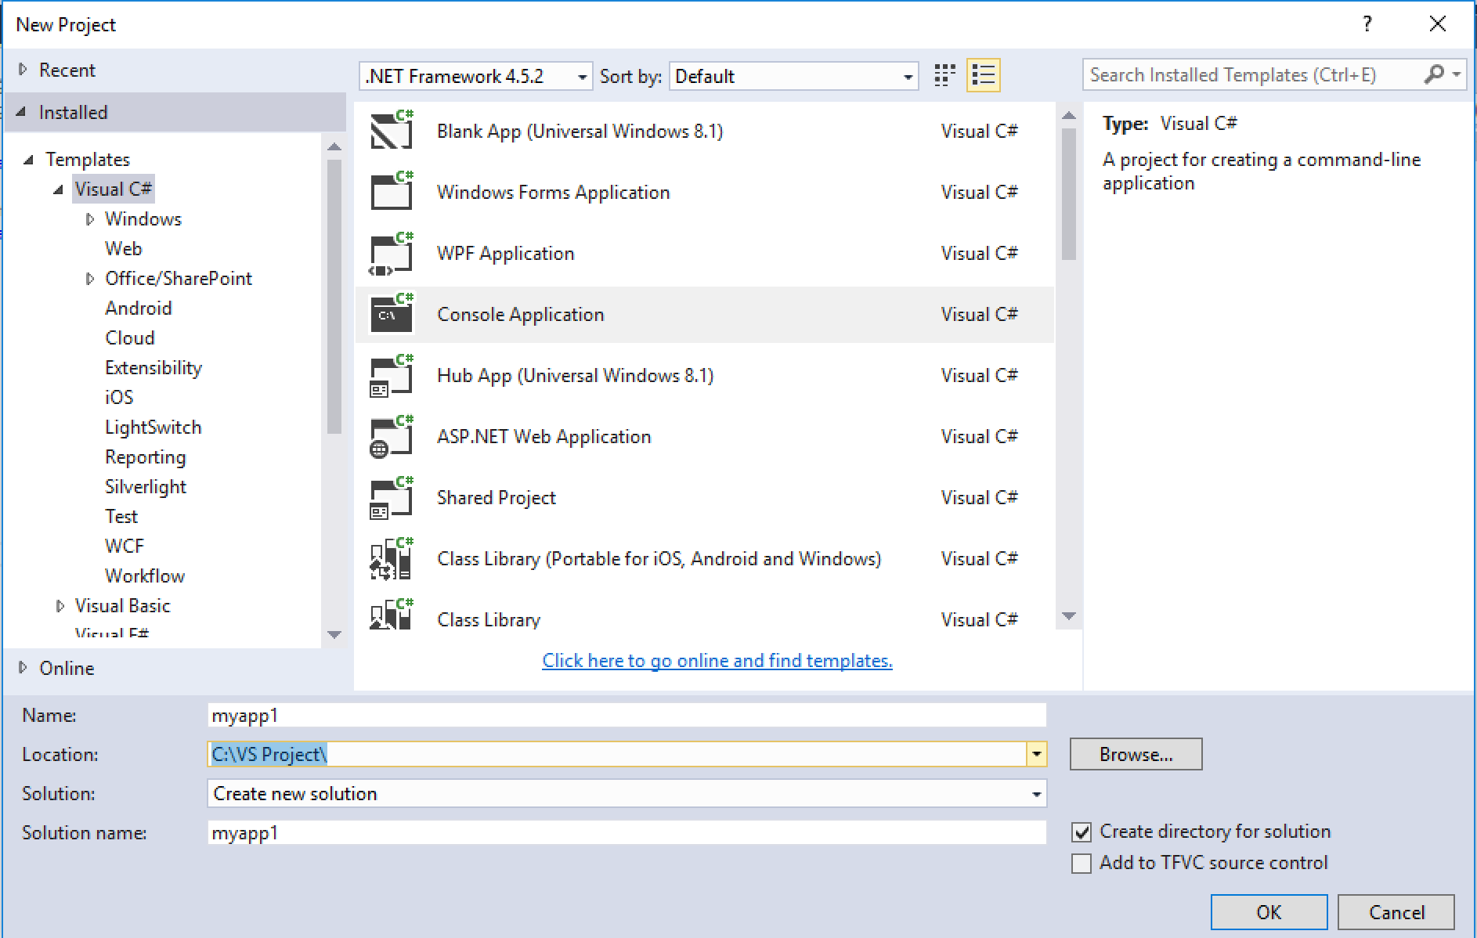
A HelloWorld program in C#

Slide 20
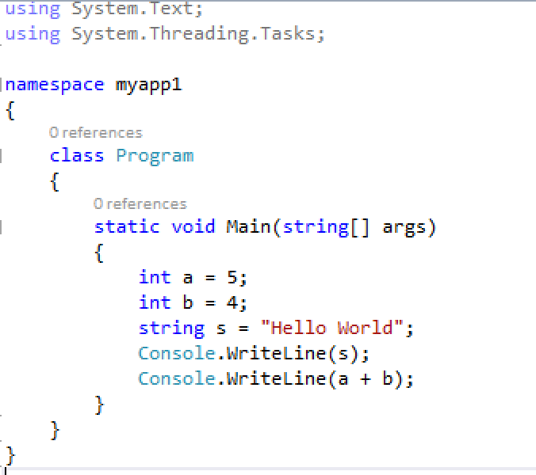
The code of new app

Slide 21

Run the app and the output

Slide 22
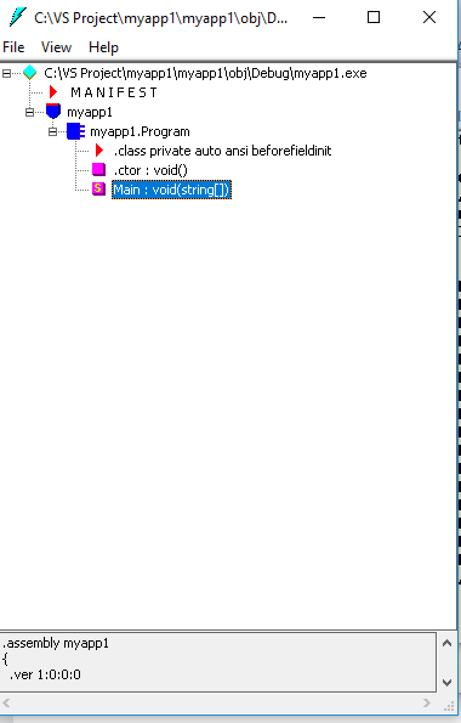
View Intermediate Language(IL) of the program
Open the tool ILDASM and select file .EXE in the Debug folder

Slide 23
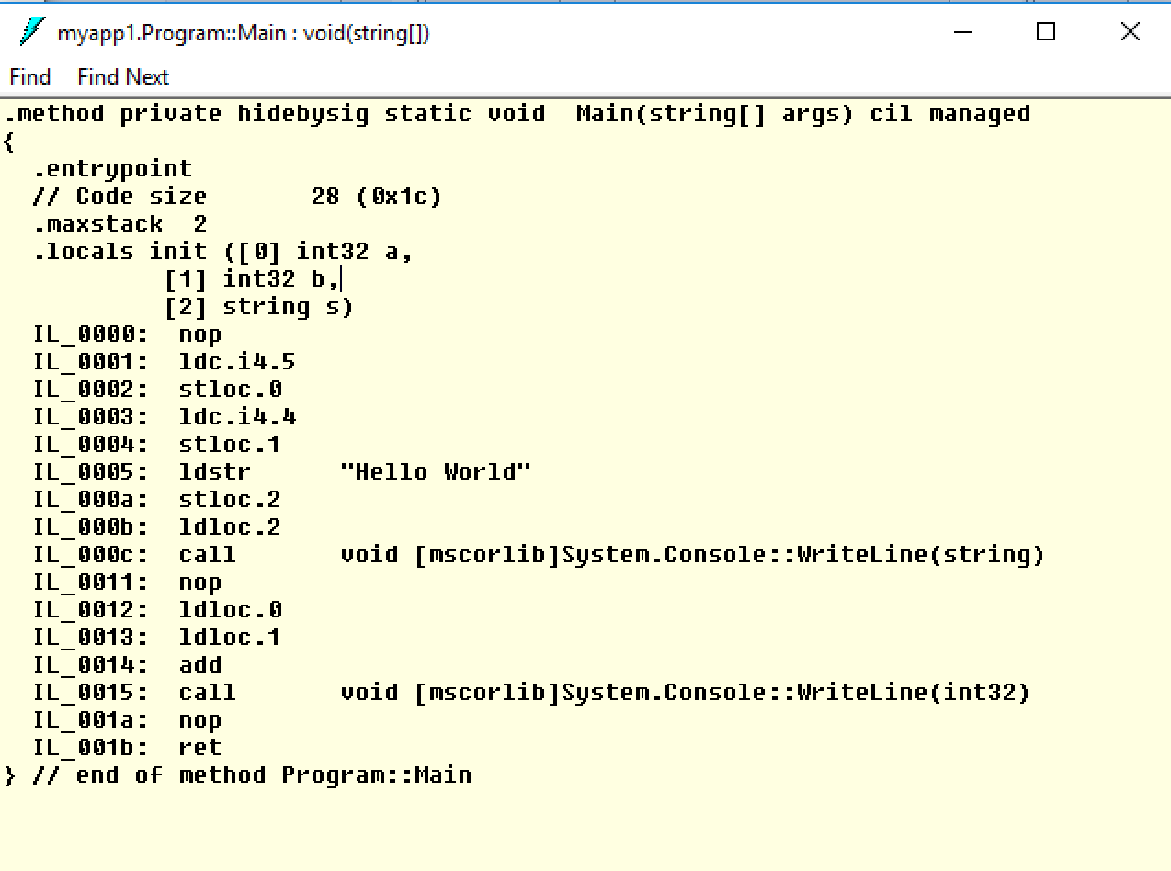
The IL of Main method

Slide 24
Explanation of the code
.entrypoint : The first function of the program from where the execution will start
maxstack 2 : The maximum number of items we will load in the memory (evaluation stack actually)
.locals : declared variables
nop that specifies that no operation is to be done yet
Ldc_i4 : Pushes a supplied value of type int32 onto the evaluation stack as an int32
Stloc.0 : Pops the current value from the top of the evaluation stack and stores it in a the local variable list at index 0
Ldloc : Loads the local variable at a specific index onto the evaluation stack
Call : (invokes) a method which resides in the mscorlib library, Method arguments arg1 through argN are popped from the stack; The return value is pushed onto the stack

Slide 25
More about MSIL
A full of Opcode can be found at
https://docs.microsoft.com/en-us/dotnet/api/system.reflection.emit.opcodes.call?view=netframework-4.8
Good tutorial about MSIL
https://www.codeproject.com/Articles/3778/Introduction-to-IL-Assembly-Language
https://www.c-sharpcorner.com/UploadFile/ajyadav123/msil-programming-part-1/
Integrate ILDASM into Visual Studio
https://dailydotnettips.com/did-you-know-you-can-launch-ildasm-tool-from-inside-visual-studio-itself-how/

Slide 26
Exercise
Draw the stack after each statement is called in the previous program
Create a program to find the greatest between 2 numbers and see how IL code looks like.

Slide 27
View Disassembly code
The Disassembly window shows assembly code corresponding to the instructions created by the compiler
If you're debugging managed code, these assembly instructions correspond to the native code created by the Just-in-Time (JIT) compiler, not the Microsoft intermediate language (MSIL) created by the Visual Studio compiler

Slide 28

Native code in the previous example

Slide 29
How to view native code in VS
https://docs.microsoft.com/en-us/visualstudio/debugger/how-to-use-the-disassembly-window?view=vs-2019
https://www.c-sharpcorner.com/uploadfile/ae35ca/disassemble-code-in-visual-studio-instead-of-ildsam-disassembler/

Slide 30
References
.NET Framework, .NET Core, Xamarin, and .NET Standard are related and overlapping platforms for developers used to build applications and services.

